Slide 1
Syndi
Team ARK presents
the one utility software every student should have

Slide 2
Introduction
Ever thought of downloading others files on LAN network on same subnet. Well you might have done that in the Windows Explorer which takes a lot of time and struggle for you to do that.
So we came up here with a solution to this problem.
Why Syndi
Downloading your files from other systems is available in Windows Explorer too. Why we made it again? Well there are several reasons for that. With the increase in the usage of systems in this world downloading or sharing the files on the same subnet became common.
Windows is inefficient to give the functionalities expected by the user in today world. We came up with a brilliant solution keeping in mind the requirements of every computer user in today world.

Slide 3
Windows experience…
Consider the time required to download or search a particular file or folder from the shared systems on your LAN or searching for all the video/audio/docs available in a particular PC on your shared network …
Doing it Manually on Windows: ☹

Slide 4
Features of the software
The user can easily share his files and he can organize them with single click.
The user can see which all systems on the network are active and which systems are sharing which type of files, size of files, categories of files shared etc, etc…
The user can easily download files with one click by using our File Explorer.
Customised search bar with advanced filtering.
The user can open the files directly from our File Explorer and stream it online before downloading. It can be a audio, video, pdf, doc, ppt, 3-D video file. Any kind of file can be viewed on our File Explorer.
Review your history of the previously visited files .

Slide 5
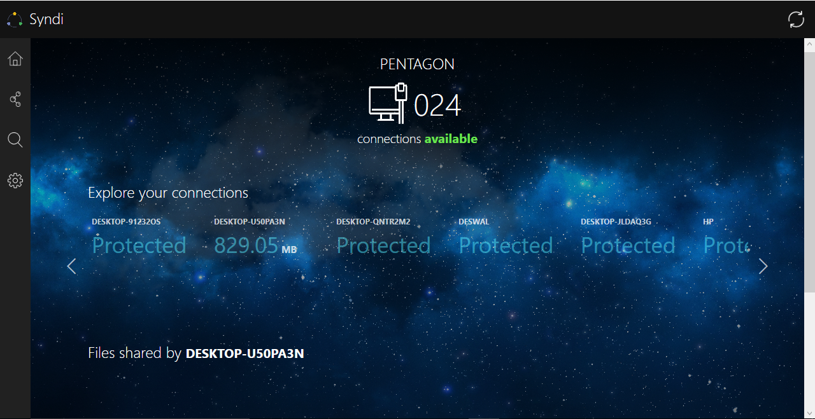
Syndi2.0

Slide 6
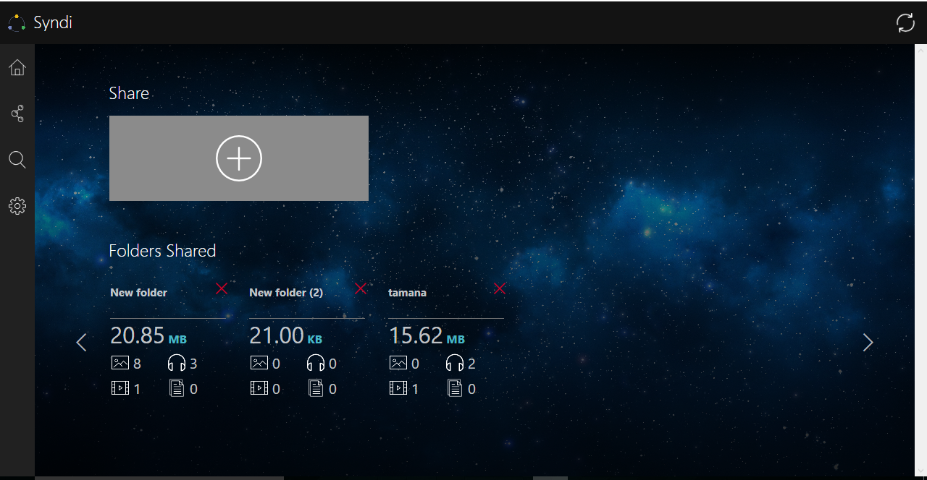
Syndi2.0

Slide 7
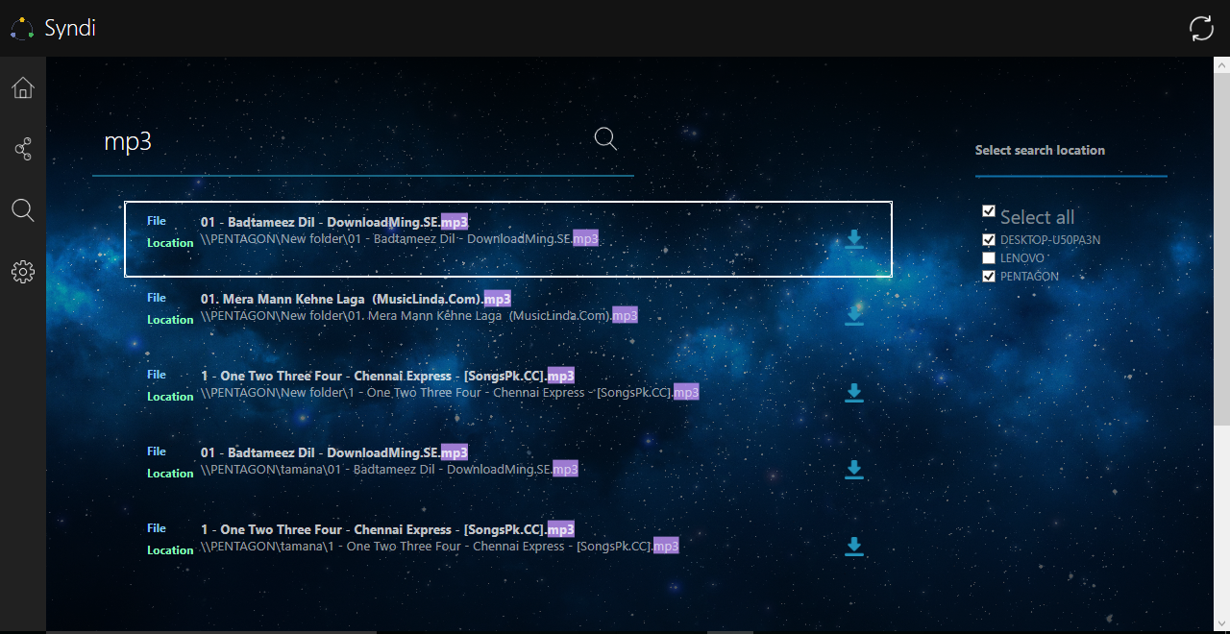
Syndi2.0

Slide 8
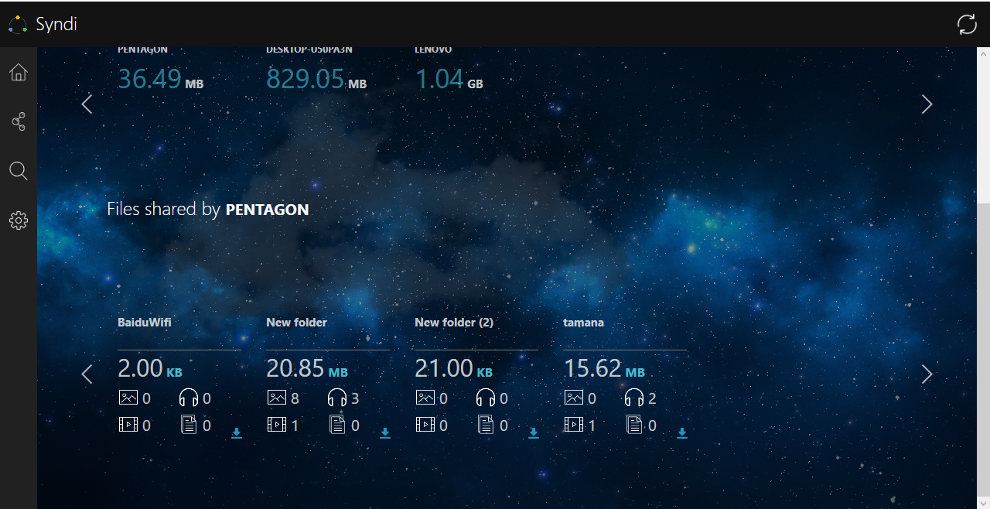
Syndi2.0

Slide 9
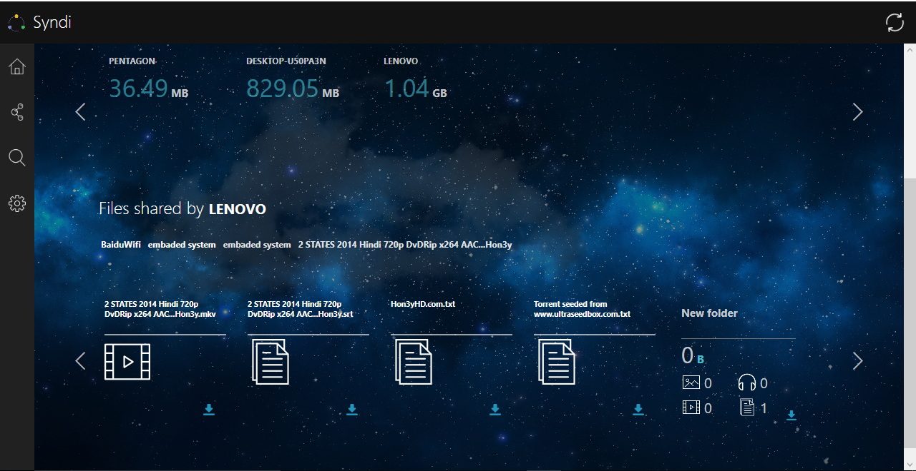
Syndi2.0

Slide 10
Syndi2.0 vs Windows Explorer
Our explorer gives more accurate results than the Windows Explorer.
Syndi search bar is far better than Windows search bar w.r.t time and functionalities.
The next slide shows a proof why our Explorer is better than the Windows Explorer.

Slide 11
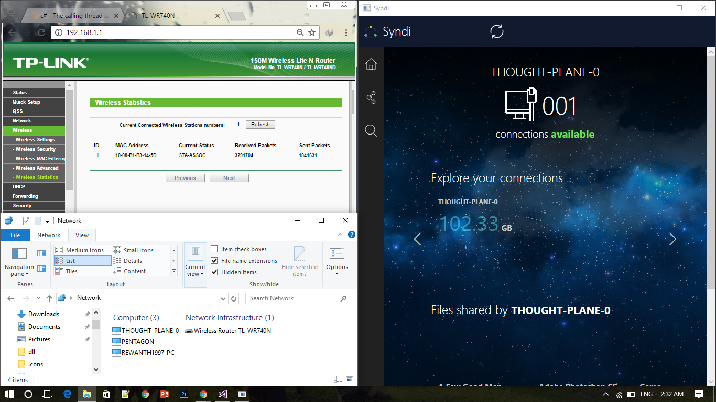
Syndi2.0 vs Windows Explorer

Slide 12
Future Scope and plans
We will be implementing a chat option by which the user can communicate with other users and ask for particular files to share if any other user is having them. There will be a private chat as well as a broadcast chat.
Currently this is available only for Windows, we would soon release our next version for cross platform.

